Slide 1
CS 152 Computer Architecture and Engineering CS252A Graduate Computer Architecture Lecture 3 - Pipelining
Krste Asanovic
Electrical Engineering and Computer Sciences
University of California at Berkeley
http://www.eecs.berkeley.edu/~krste
http://inst.eecs.berkeley.edu/~cs152

Slide 2
Q&A in lecture
Please post on Piazza thread so we can capture Q&A for others, and stay muted during lecture
I’ll answer some questions live in break and at end of lecture with recording paused to avoid recording your voice.

Slide 3
Last Time in Lecture 2
Microcoding, an effective technique to manage control unit complexity, invented in era when logic (tubes), main memory (magnetic core), and ROM (diodes) used different technologies
Difference between ROM and RAM speed motivated additional complex instructions
Technology advances leading to fast SRAM made technology assumptions invalid
Complex instructions sets impede parallel and pipelined implementations

Slide 4
Recap: Microprogramming in IBM 360
 | M30 | M40 | M50 | M65
Datapath width (bits) | 8 | 16 | 32 | 64
µinst width (bits) | 50 | 52 | 85 | 87
µcode size (K µinsts) | 4 | 4 | 2.75 | 2.75
µstore technology | CCROS | TCROS | BCROS | BCROS
µstore cycle (ns) | 750 | 625 | 500 | 200
memory cycle (ns) | 1500 | 2500 | 2000 | 750
Rental fee ($K/month) | 4 | 7 | 15 | 35
Only the fastest models (75 and 95) were hardwired

Slide 5
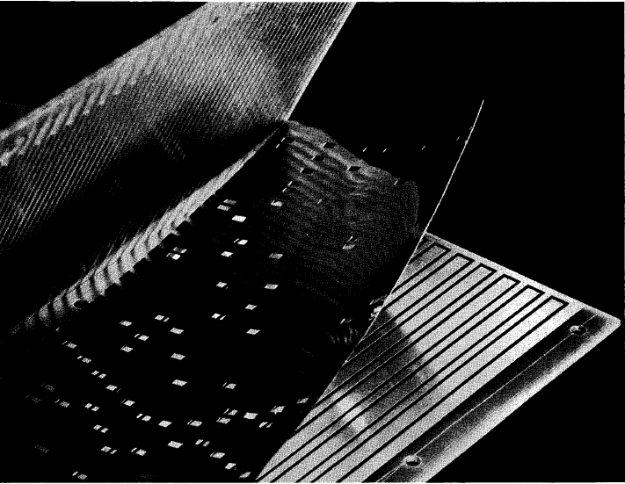
IBM Card-Capacitor Read-Only Storage
Punched Card with metal film
Fixed sensing plates
[ IBM Journal, January 1961]

Slide 6
Microcode Emulation
IBM initially miscalculated the importance of software compatibility with earlier models when introducing the 360 series
Honeywell stole some IBM 1401 customers by offering translation software (“Liberator”) for Honeywell H200 series machine
IBM retaliated with optional additional microcode for 360 series that could emulate IBM 1401 ISA, later extended for IBM 7000 series
one popular program on 1401 was a 650 simulator, so some customers ran many 650 programs on emulated 1401s
i.e., 650 simulated on 1401 emulated on 360

Slide 7
Microprogramming thrived in ‘60s and ‘70s
Significantly faster ROMs than DRAMs were available
For complex instruction sets, datapath and controller were cheaper and simpler
New instructions , e.g., floating point, could be supported without datapath modifications
Fixing bugs in the controller was easier
ISA compatibility across various models could be achieved easily and cheaply
Except for the cheapest and fastest machines, all computers were microprogrammed

Slide 8
Microprogramming: early 1980s
Evolution bred more complex micro-machines
Complex instruction sets led to need for subroutine and call stacks in µcode
Need for fixing bugs in control programs was in conflict with read-only nature of µROM
➔Writable Control Store (WCS) (B1700, QMachine, Intel i432, …)
With the advent of VLSI technology assumptions about ROM & RAM speed became invalid →more complexity
Better compilers made complex instructions less important.
Use of numerous micro-architectural innovations, e.g., pipelining, caches and buffers, made multiple-cycle execution of reg-reg instructions unattractive

Slide 9
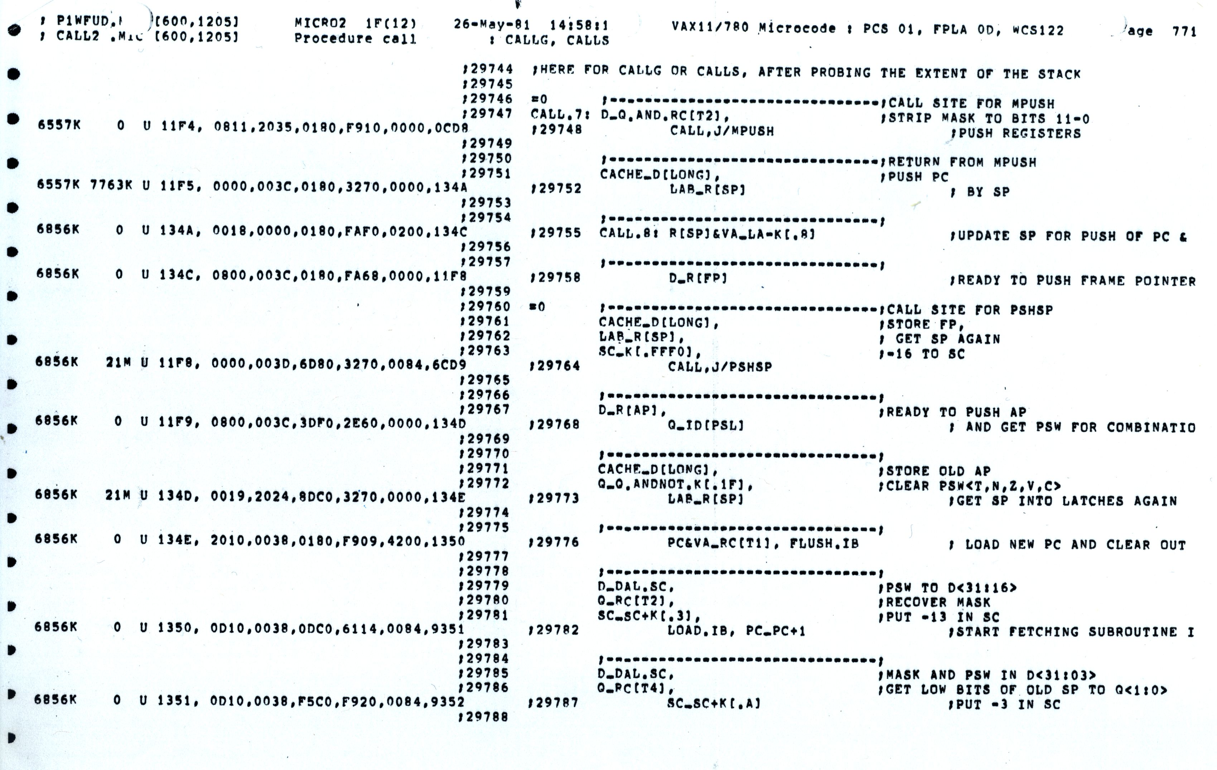
VAX 11-780 Microcode

Slide 10
Writable Control Store (WCS)
Implement control store in RAM not ROM
MOS SRAM memories now almost as fast as control store (core memories/DRAMs were 2-10x slower)
Bug-free microprograms difficult to write
User-WCS provided as option on several minicomputers
Allowed users to change microcode for each processor
User-WCS failed
Little or no programming tools support
Difficult to fit software into small space
Microcode control tailored to original ISA, less useful for others
Large WCS part of processor state - expensive context switches
Protection difficult if user can change microcode
Virtual memory required restartable microcode

Slide 11
Microprogramming is far from extinct
Played a crucial role in micros of the Eighties
DEC uVAX, Motorola 68K series, Intel 286/386
Plays an assisting role in most modern micros
e.g., AMD Zen, Intel Sky Lake, Intel Atom, IBM PowerPC, …
Most instructions executed directly, i.e., with hard-wired control
Infrequently-used and/or complicated instructions invoke microcode
Patchable microcode common for post-fabrication bug fixes, e.g. Intel processors load µcode patches at bootup
Intel had to scramble to resurrect microcode tools and find original microcode engineers to patch Meltdown/Spectre security vulnerabilites

Slide 12
Analyzing Microcoded Machines
John Cocke and group at IBM
Working on a simple pipelined processor, 801, and advanced compilers inside IBM
Ported experimental PL.8 compiler to IBM 370, and only used simple register-register and load/store instructions similar to 801
Code ran faster than other existing compilers that used all 370 instructions! (up to 6MIPS whereas 2MIPS considered good before)
Emer, Clark, at DEC
Measured VAX-11/780 using external hardware
Found it was actually a 0.5MIPS machine, although usually assumed to be a 1MIPS machine
Found 20% of VAX instructions responsible for 60% of microcode, but only account for 0.2% of execution time!
VAX8800
Control Store: 16K*147b RAM, Unified Cache: 64K*8b RAM
4.5x more microstore RAM than cache RAM!

Slide 13
“Iron Law” of Processor Performance
Time = Instructions Cycles Time
Program Program * Instruction * Cycle
Instructions per program depends on source code, compiler technology, and ISA
Cycles per instructions (CPI) depends on ISA and µarchitecture
Time per cycle depends upon the µarchitecture and base technology

Slide 14
CPI for Microcoded Machine
7 cycles
5 cycles
10 cycles
Inst 1
Inst 2
Inst 3
Time
Total clock cycles = 7+5+10 = 22
Total instructions = 3
CPI = 22/3 = 7.33
CPI is always an average over a large number of instructions.

Slide 15
IC Technology Changes Tradeoffs
Logic, RAM, ROM all implemented using MOS transistors
Semiconductor RAM ~ same speed as ROM

Slide 16
Reconsidering Microcode Machine (Nanocoded 68000 example)
RISC!
User PC
Exploits recurring control signal patterns in µcode, e.g.,
ALU0 A ← Reg[rs1]
...
ALUI0 A ← Reg[rs1]
...
µcode
next-state
µPC (state)
µaddress
Inst. Cache
µcode ROM
nanoaddress
Hardwired Decode
nanoinstruction ROM
data
Motorola 68000 had 17-bit µcode containing either 10-bit µjump or 9-bit nanoinstruction pointer
Nanoinstructions were 68 bits wide, decoded to give 196 control signals

Slide 17
From CISC to RISC
Use fast RAM to build fast instruction cache of user-visible instructions, not fixed hardware microroutines
Contents of fast instruction memory change to fit application needs
Use simple ISA to enable hardwired pipelined implementation
Most compiled code only used few CISC instructions
Simpler encoding allowed pipelined implementations
RISC ISA comparable to vertical microcode
Further benefit with integration
In early ‘80s, finally fit 32-bit datapath + small caches on single chip
No chip crossings in common case allows faster operation

Slide 18
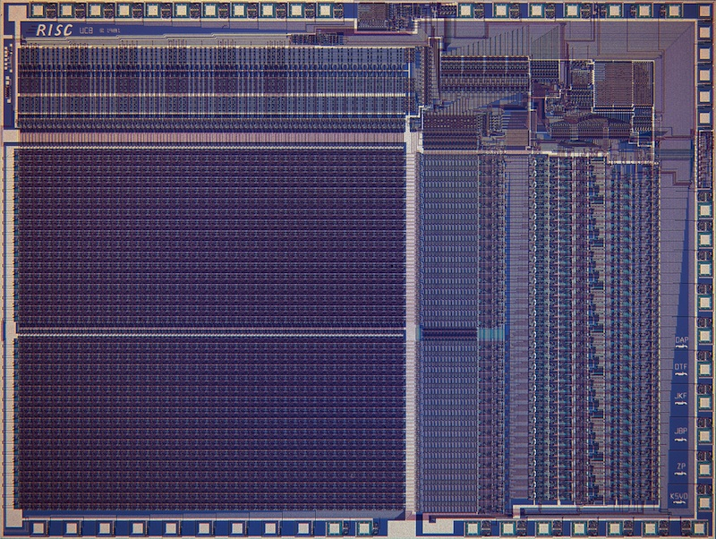
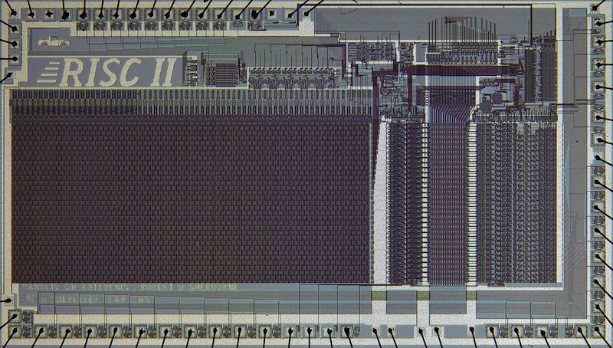
Berkeley RISC Chips
RISC-I (1982) Contains 44,420 transistors, fabbed in 5 µm NMOS, with a die area of 77 mm², ran at 1 MHz. This chip is probably the first VLSI RISC.
RISC-II (1983) contains 40,760 transistors, was fabbed in 3 µm NMOS, ran at 3 MHz, and the size is 60 mm².
Stanford built some too…

Slide 19
“Iron Law” of Processor Performance
Time = Instructions Cycles Time
Program Program * Instruction * Cycle
Instructions per program depends on source code, compiler technology, and ISA
Cycles per instructions (CPI) depends on ISA and µarchitecture
Time per cycle depends upon the µarchitecture and base technology
Microarchitecture | CPI | cycle time
Microcoded | >1 | short
Single-cycle unpipelined | 1 | long
Pipelined | 1 | short

Slide 20
Classic 5-Stage RISC Pipeline
Fetch
Decode
EXecute
Memory
Writeback
Imm
Data Cache
Store
Instruction Cache
Inst. Register
B
PC
Registers
ALU
A
This version designed for regfiles/memories with synchronous reads and writes.

Slide 21
CPI Examples
Microcoded machine
Time
7 cycles
5 cycles
10 cycles
Inst 1
Inst 2
Inst 3
3 instructions, 22 cycles, CPI=7.33
Unpipelined machine
Inst 1
Inst 2
Inst 3
3 instructions, 3 cycles, CPI=1
Pipelined machine
Inst 1
3 instructions, 3 cycles, CPI=1
Inst 2
Inst 3
5-stage pipeline CPI≠5!!!

Slide 22
Instructions interact with each other in pipeline
An instruction in the pipeline may need a resource being used by another instruction in the pipeline → structural hazard
An instruction may depend on something produced by an earlier instruction
Dependence may be for a data value → data hazard
Dependence may be for the next instruction’s address → control hazard (branches, exceptions)
Handling hazards generally introduces bubbles into pipeline and reduces ideal CPI > 1

Slide 23
Pipeline CPI Examples
Measure from when first instruction finishes to when last instruction in sequence finishes.
Time
Inst 1
Inst 2
3 instructions finish in 3 cycles
CPI = 3/3 =1
Inst 3
Inst 1
Inst 2
3 instructions finish in 4 cycles
CPI = 4/3 = 1.33
Bubble
Inst 3
Inst 1
Bubble 1
Inst 2
3 instructions finish in 5cycles
CPI = 5/3 = 1.67
Inst 3
Bubble 2
Inst 3

Slide 24
Resolving Structural Hazards
Structural hazard occurs when two instructions need same hardware resource at same time
Can resolve in hardware by stalling newer instruction till older instruction finished with resource
A structural hazard can always be avoided by adding more hardware to design
E.g., if two instructions both need a port to memory at same time, could avoid hazard by adding second port to memory
Classic RISC 5-stage integer pipeline has no structural hazards by design
Many RISC implementations have structural hazards on multi-cycle units such as multipliers, dividers, floating-point units, etc., and can have on register writeback ports

Slide 25
Types of Data Hazards
Consider executing a sequence of register-register instructions of type:
r_{k} ← r_{i} op r_{j}
Data-dependence
r₃ ← r₁ op r₂ Read-after-Write
r₅ ← r₃ op r₄ (RAW) hazard
Anti-dependence
r₃ ← r₁ op r₂ Write-after-Read
r₁ ← r₄ op r₅ (WAR) hazard
Output-dependence
r₃ ← r₁ op r₂ Write-after-Write
r₃ ← r₆ op r₇ (WAW) hazard

Slide 26
Three Strategies for Data Hazards
Interlock
Wait for hazard to clear by holding dependent instruction in issue stage
Bypass
Resolve hazard earlier by bypassing value as soon as available
Speculate
Guess on value, correct if wrong

Slide 27
Interlocking Versus Bypassing
add x1, x3, x5
sub x2, x1, x4
F
D
X
M
W
add x1, x3, x5
F
D
X
M
W
bubble
Instruction interlocked in decode stage
F
D
X
M
W
bubble
F
D
X
M
W
bubble
F
D
X
M
W
sub x2, x1, x4
F
D
X
M
W
add x1, x3, x5
Bypass around ALU with no bubbles
F
D
X
M
W
sub x2, x1, x4

Slide 28
Example Bypass Path
Fetch
Decode
EXecute
Memory
Writeback
Imm
Data Cache
Store
Instruction Cache
Inst. Register
B
PC
Registers
ALU
A

Slide 29
Fully Bypassed Data Path
Fetch
Decode
EXecute
Memory
Writeback
Imm
Data Cache
Store
Instruction Cache
Inst. Register
B
PC
Registers
ALU
A
F
D
X
M
W
[ Assumes data written to registers in a W cycle is readable in parallel D cycle (dotted line). Extra write data register and bypass paths required if this is not possible. ]
F
D
X
M
W
F
D
X
M
W
F
D
X
M
W

Slide 30
Value Speculation for RAW Data Hazards
Rather than wait for value, can guess value!
So far, only effective in certain limited cases:
Branch prediction
Stack pointer updates
Memory address disambiguation

Slide 31
CS152 Administrivia
PS 1 is posted, due 11:59PM on Monday Feb 8
Lab 1 out today, due 11:59PM Wed Feb 17
Lab 1 overview in Sections on Friday
There will be live demo walking through lab install process
Midterm and final exams will use remote proctoring
Details TBD, awaiting further instruction from campus

Slide 32
CS252A Administrivia
CS252 discussions grading policy
We’ll ignore your two lowest scores in grading, which includes absences
Send in summary even if you can’t attend discussion
CS252 Piazza class has been created
Sign up for this as well as CS152 Piazza
Each CS252 paper has dedicated thread
Post your response as private note to instructors
Due Wednesday evening before Thursday discussion section

Slide 33
Control Hazards
What do we need to calculate next PC?
For Unconditional Jumps
Opcode, PC, and offset
For Jump Register
Opcode, Register value, and offset
For Conditional Branches
Opcode, Register (for condition), PC and offset
For all other instructions
Opcode and PC ( and have to know it’s not one of above )

Slide 34
Control flow information in pipeline
Fetch
Decode
EXecute
Memory
Writeback
Branch condition, Jump register value known
Opcode,
offset known
PC known
Imm
Data Cache
Store
Instruction Cache
Inst. Register
B
PC
Registers
ALU
A

Slide 35
RISC-V Unconditional PC-Relative Jumps
PCJumpSel
FKill
Jump?
[ Kill bit turns instruction into a bubble ]
PC_decode
Add
+4
Imm
Kill
Instruction Cache
B
ALU
PC_fetch
Inst. Register
Registers
A
Fetch
Decode
EXecute

Slide 36
Pipelining for Unconditional PC-Relative Jumps
F
D
X
M
W
j target
F
D
X
M
W
bubble
F
D
X
M
W
target: add x1, x2, x3

Slide 37
Branch Delay Slots
Early RISCs adopted idea from pipelined microcode engines, and changed ISA semantics so instruction after branch/jump is always executed before control flow change occurs:
0x100 j target
0x104 add x1, x2, x3 // Executed before target
…
0x205 target: xori x1, x1, 7
Software has to fill delay slot with useful work, or fill with explicit NOP instruction
F
D
X
M
W
j target
F
D
X
M
W
add x1, x2, x3
F
D
X
M
W
target: xori x1, x1, 7

Slide 38
Post-1990 RISC ISAs don’t have delay slots
Encodes microarchitectural detail into ISA
c.f. IBM 650 drum layout
Performance issues
Increased I-cache misses from NOPs in unused delay slots
I-cache miss on delay slot causes machine to wait, even if delay slot is a NOP
Complicates more advanced microarchitectures
Consider 30-stage pipeline with four-instruction-per-cycle issue
Better branch prediction reduced need
Branch prediction in later lecture

Slide 39
RISC-V Conditional Branches
PCSel
Branch?
DKill
FKill
Cond?
PC_execute
PC_decode
Add
Add
+4
Kill
Kill
Instruction Cache
Inst.
PC_fetch
Inst. Register
B
ALU
Registers
A
Fetch
Decode
EXecute

Slide 40
Pipelining for Conditional Branches
F
D
X
M
W
beq x1, x2, target
F
D
X
M
W
bubble
F
D
X
M
W
bubble
F
D
X
M
W
target: add x1, x2, x3

Slide 41
Pipelining for Jump Register
Register value obtained in execute stage
F
D
X
M
W
jr x1
F
D
X
M
W
bubble
F
D
X
M
W
bubble
F
D
X
M
W
target: add x5, x6, x7

Slide 42
Why instruction may not be dispatched every cycle in classic 5-stage pipeline (CPI>1)
Full bypassing may be too expensive to implement
typically all frequently used paths are provided
some infrequently used bypass paths may increase cycle time and counteract the benefit of reducing CPI
Loads have two-cycle latency
Instruction after load cannot use load result
MIPS-I ISA defined load delay slots, a software-visible pipeline hazard (compiler schedules independent instruction or inserts NOP to avoid hazard). Removed in MIPS-II (pipeline interlocks added in hardware)
MIPS:“Microprocessor without Interlocked Pipeline Stages”
Jumps/Conditional branches may cause bubbles
kill following instruction(s) if no delay slots
Machines with software-visible delay slots may execute significant number of NOP instructions inserted by the compiler.
NOPs reduce CPI, but increase instructions/program!

Slide 43
Traps and Interrupts
In class, we’ll use following terminology
Exception: An unusual internal event caused by program during execution
E.g., page fault, arithmetic underflow
Interrupt: An external event outside of running program
Trap: Forced transfer of control to supervisor caused by exception or interrupt
Not all exceptions cause traps (c.f. IEEE 754 floating-point standard)

Slide 44
History of Exception Handling
Analytical Engine had overflow exceptions
First system with traps was Univac-I, 1951
Arithmetic overflow would either
1. trigger the execution a two-instruction fix-up routine at address 0, or
2. at the programmer's option, cause the computer to stop
Later Univac 1103, 1955, modified to add external interrupts
Used to gather real-time wind tunnel data
First system with I/O interrupts was DYSEAC, 1954
Had two program counters, and I/O signal caused switch between two PCs
Also, first system with DMA (Direct Memory Access by I/O device)
And, first mobile computer!

Slide 45
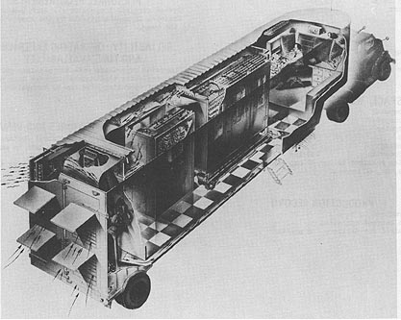
DYSEAC, first mobile computer!
Carried in two tractor trailers, 12 tons + 8 tons
Built for US Army Signal Corps
[Courtesy Mark Smotherman]

Slide 46
Asynchronous Interrupts
An I/O device requests attention by asserting one of the prioritized interrupt request lines
When the processor decides to process the interrupt
It stops the current program at instruction I_{i} , completing all the instructions up to I_{i-1} (precise interrupt)
It saves the PC of instruction I_{i} in a special register (EPC)
It disables interrupts and transfers control to a designated interrupt handler running in supervisor mode

Slide 47
Trap: altering the normal flow of control
I_{i-1}
HI₁
trap
handler
program
I_{i}
HI₂
I_{i+1}
HI_{n}
An external or internal event that needs to be processed by another (system) program. The event is usually unexpected or rare from program’s point of view.

Slide 48
Trap Handler
Saves EPC before enabling interrupts to allow nested interrupts ⇒
need an instruction to move EPC into GPRs
need a way to mask further interrupts at least until EPC can be saved
Needs to read a status register that indicates the cause of the trap
Uses a special indirect jump instruction ERET (return-from-environment) which
enables interrupts
restores the processor to the user mode
restores hardware status and control state

Slide 49
Synchronous Trap
A synchronous trap is caused by an exception on a particular instruction
In general, the instruction cannot be completed and needs to be restarted after the exception has been handled
requires undoing the effect of one or more partially executed instructions
In the case of a system call trap, the instruction is considered to have been completed
a special jump instruction involving a change to a privileged mode

Slide 50
Exception Handling 5-Stage Pipeline
PC
Inst. Mem
D
Decode
E
M
Data Mem
W
+
PC address Exception
Illegal Opcode
Overflow
Data address Exceptions
Asynchronous Interrupts
How to handle multiple simultaneous exceptions in different pipeline stages?
How and where to handle external asynchronous interrupts?

Slide 51
Exception Handling 5-Stage Pipeline
Commit Point
PC
Inst. Mem
D
Decode
E
M
Data Mem
W
+
Illegal Opcode
Overflow
Data address Exceptions
PC address Exception
Exc
D
Exc
E
Exc
M
Cause
PC
D
PC
E
PC
M
EPC
Select Handler PC
Kill F Stage
Kill D Stage
Kill E Stage
Asynchronous
Interrupts
Kill Writeback

Slide 52
Exception Handling 5-Stage Pipeline
Hold exception flags in pipeline until commit point (M stage)
Exceptions in earlier pipe stages override later exceptions for a given instruction
Inject external interrupts at commit point (override others)
If trap at commit: update Cause and EPC registers, kill all stages, inject handler PC into fetch stage

Slide 53
Speculating on Exceptions
Prediction mechanism
Exceptions are rare, so simply predicting no exceptions is very accurate!
Check prediction mechanism
Exceptions detected at end of instruction execution pipeline, special hardware for various exception types
Recovery mechanism
Only write architectural state at commit point, so can throw away partially executed instructions after exception
Launch exception handler after flushing pipeline
Bypassing allows use of uncommitted instruction results by following instructions

Slide 54
Acknowledgements
This course is partly inspired by previous MIT 6.823 and Berkeley CS252 computer architecture courses created by my collaborators and colleagues:
Arvind (MIT)
Joel Emer (Intel/MIT)
James Hoe (CMU)
John Kubiatowicz (UCB)
David Patterson (UCB)

